Slide 1

The .NET Framework Class Library
Dr. Wolfgang Beer
Software Competence Center Hagenberg
Dr. Herbert Praehofer
Institute for System Software
Johannes Kepler University Linz
© University of Linz, Institute for System Software, 2004
published under the Microsoft Curriculum License
Notes:
Überblick

Slide 2
Collections
Collections = sets, lists, and dictionaries of objects
C# only supports arrays
.NET class library contains namespaces for object collections
  System.Collections: untyped collections
  System.Collections.Generic (since .NET 2.0): typed (generic) collections

Slide 3
.NET Framework Class Library
Overview
Collections
Untyped Collections
Typed Collections
Reflection
Threading
Streaming
Processing XML Data
Networking
Windows Forms
Summary
Notes:
Überblick

Slide 4
Collections
Types for dealing with sets, lists and dictionaries
IEnumerable
IEnumerator GetEnumerator()
IEnumerator
Object Current
bool MoveNext()
void Reset()
ICollection
int Count
void CopyTo(Array a, int pos)
namespace System.Collections
IList
object this[int i]
void Clear()
int Add(object x)
void Insert(int pos, object x)
void Remove(object x)
void RemoveAt(int pos)
bool Contains(object x)
int IndexOf(object x)
IDictionary
ICollection Keys
ICollection Values
object this[object key]
void Clear()
void Add(object key, object value)
void Remove(object key)
bool Contains(object key)
Stack
Queue
BitArray
No special type for sets
Array
ArrayList
ListDictionary
Hashtable
SortedList
Notes:
Überblick

Slide 5
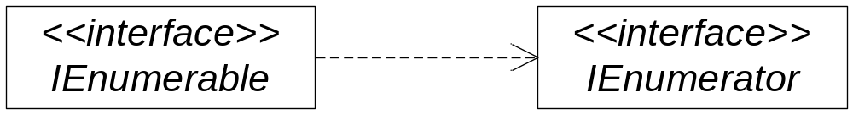
IEnumerable and IEnumerator (1)
Anything which is enumerable is represented by interface IEnumerable
IEnumerator realizes an iterator
interface IEnumerable {
IEnumerator GetEnumerator();
}
interface IEnumerator {
object Current {get;}
bool MoveNext();
void Reset();
}
Notes:
Überblick

Slide 6
IEnumerable and IEnumerator (2)
Classes which implement IEnumerable are:
  Array
  ArrayList
  String
  Hashtable
  and many more.
For all IEnumerables foreach–statement can be used
Example:
int[] a = {1, 6, 8, 9, 15}; // object of abstract type Array
foreach (int i in a) System.Console.WriteLine(i);
Notes:
Überblick

Slide 7
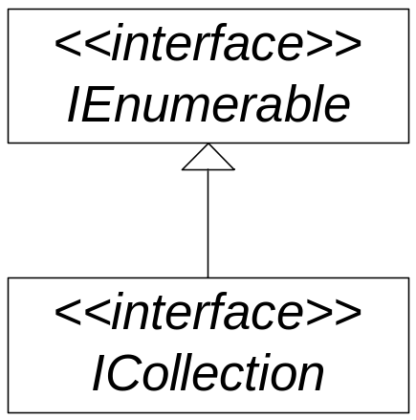
Interface ICollection
Basic interface for collections
int Count {get;}
  number of elements
bool IsSynchronized {get;}
  collection synchronised?
object SyncRoot {get;}
  returns object for synchronisation
void CopyTo(Array a, int index);
  copies the elements into array (starting at position index)
interface ICollection {
//---- Properties
int Count {get;}
bool IsSynchronized {get;}
object SyncRoot {get;}
//---- Methods
void CopyTo(Array a, int index);
}
Notes:
Überblick

Slide 8
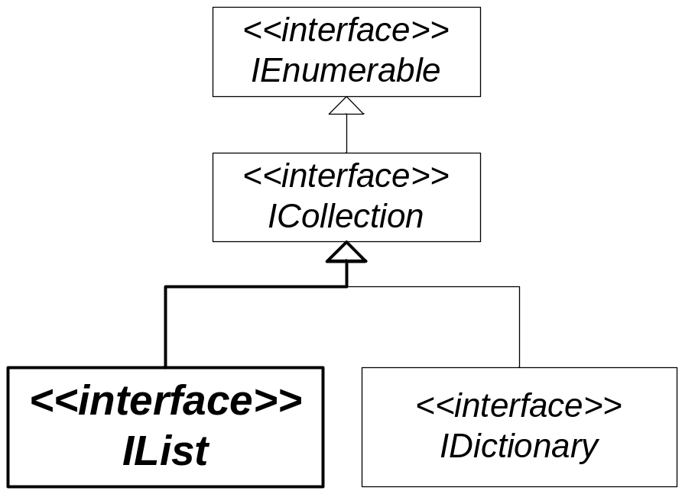
Interface IList
Interface for object collections with a defined order
interface IList {
object this [ int index ] {get; set;}
int Add(object value);
void Insert(int index,object value);
void Remove(object value);
void RemoveAt(int index);
void Clear();
bool Contains(object value);
bool IsFixedSize {get;}
bool IsReadOnly {get;}
...
}
Indexer for accessing elements based on position
Adding,
inserting and
removing elements
Testing containment of elements
Is list of fixed length?
Is list read-only?
Notes:
Überblick

Slide 9
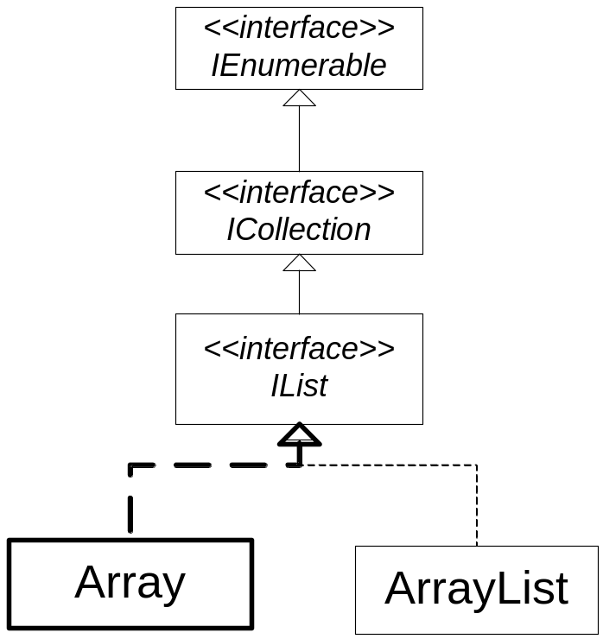
Class Array (1)
Arrays in .NET are instances of classes derived from base class Array
Array implements IList, ICollection and IEnumerable
Arrays are of fixed size (isFixedSize == true)
Array provides a rich interface
public abstract class Array :
ICloneable, IList, ICollection, IEnumerable {
//---- Properties
public int Length {get;}
public int Rank {get;}
//----- Methods
public int GetLength(int dimension);
public int GetLowerBound(int dimension);
public int GetUpperBound(int dimension);
public object GetValue(int idx);
public object GetValue(int[] idx);
public void SetValue(object val, int idx);
public void SetValue(object val, int[] idx);
Getting length and number of dimensions
Getting length and lower and upper bound for each dimension
Getting and setting values
Notes:
Überblick

Slide 10
Class Array (2)
…
//----- statische Methoden
public static int IndexOf(Array a, object val);
public static int LastIndexOf(Array a, object value);
public static void Sort(Array a);
public static void Sort(Array a, IComparer comparer);
public static void Reverse(Array a);
public static int BinarySearch(Array a, object val);
public static int BinarySearch(Array a, object val, IComparer c);
public static void Copy(Array srcArray, Array destArray, int len);
public static Array CreateInstance(Type elementType, int len);
public static Array CreateInstance(Type elementType, int[] len);
…
}
Searching for positions of elements
Sorting of arrays
Binary search in sorted arrays
Copying and creating arrays
Notes:
Überblick

Slide 11
Example Array
Creation of array with Array.CreateInstance
which is equivalent to
Setting values and sorting
Output of elements with foreach statement
int[] i = (int[]) Array.CreateInstance(typeof(Int32), 6);
int[] i = new int[6];
i[0] = 3; i[1] = 1; i[2] = 5; i[3] = 2; i[4] = 9; i[5] = 4;
Array.Sort(i); // Sorts the elements in the array
foreach (int elem in i)
Console.Write("{0} ", elem);
Elemente: 1 2 3 4 5 9
Notes:
Überblick

Slide 12
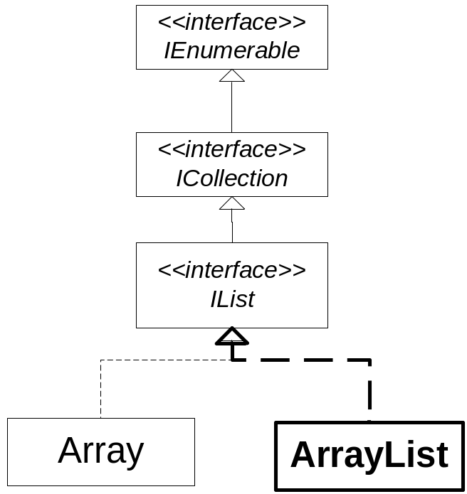
Class ArrayList (1)
ArrayList realizes dynamically growing list
public class ArrayList :
IList, ICollection, IEnumerable, ICloneable {
public ArrayList();
public ArrayList(ICollection c);
public ArrayList(int capacity);
virtual int Capacity {get;set;}
public virtual ArrayList GetRange(int index, int count);
public virtual void AddRange(ICollection c);
public virtual void InsertRange(int index, ICollection c);
public virtual void SetRange(int i, ICollection c);
public virtual void RemoveRange(int index, int count);
…
Constructors
Capacity
Accessing,
inserting,
setting,
removing elements
Notes:
Überblick

Slide 13
Class ArrayList (2)
…
public virtual void Sort();
public virtual void Reverse();
public virtual int BinarySearch(object o);
public virtual int LastIndexOf(object o);
public static ArrayList Adapter(IList list);
public static ArrayList FixedSize(ArrayList l);
public static ArrayList ReadOnly(ArrayList l);
public static ArrayList Synchronized(ArrayList list);
public virtual void CopyTo(Array a);
public virtual object[] ToArray();
public virtual void TrimToSize();
}
Sorting and searching
Creation of wrappers
Copying elements
Trimming to actual size
Notes:
Überblick
Wrappers:
Adapter: Adpats the given List to the ArrayList interface
FixedSize: returns wrapper with a fixed size
ReadOnly: returns wrapper with a read only
Synchronized: thread-safe
TrimToSize: minimize memory overhead if no new elements will be added

Slide 14
Example ArrayList
Creating ArrayList and adding values
Sorting the elements in the ArrayList
Inverting the elements in the ArrayList
ArrayList a = new ArrayList();
a.Add(3); a.Add(1); a.Add(2); a.Add(4); a.Add(9);
a.Sort();
foreach (int i in a) Console.WriteLine(i);
Elemente: 1 2 3 4 5 9
a.Reverse();
foreach (int i in a) Console.WriteLine(i);
Elemente: 9 4 3 2 1
Notes:
Überblick

Slide 15
Sorting: IComparable and IComparer
IComparable is interface for types with order
Types implementing IComparable are
  value types like Int32, Double, DateTime, …
  class Enum as base class of all enumeration types
  class String
IComparer is interface for the realization of compare operators
IComparer implementations:
  Comparer, CaseInsensitiveComparer: for string comparisons
public interface IComparable {
int CompareTo(object obj); // -1 if this < obj, 0 if this == obj, 1 if this > obj
}
public interface IComparer {
int Compare(object x, object y); // -1 if x < y, 0 if x == y, 1 if x > y
}
Notes:
Überblick

Slide 16
Example IComparer
Creation of an array of strings
Sorting the strings using a case-insensitive comparer
Binary search for a name
Inverting the array
string[] names = string[] {“frank”, “john”, “Bill”, “paul”, “Frank”};
IComparer ciComparer = new CaseInsensitiveComparer ();
Array.Sort(names, ciComparer);
int pos = Array.BinarySearch("John“, ciComparer);
names = Array.Reverse(names, ciComparer);
Notes:
Überblick

Slide 17
Example IComparable (1)
Type Vector represents two-dimensional vector
implements IComparable
sorting is done based on the length of the vector
public class Vector : IComparable {
private double x, y;
public Vector(double x, double y) { this.x = x; this.y = y; }
public double Length { get { return Math.Sqrt( x*x + y*y ); } }
public int CompareTo(object obj) {
if(obj is Vector) {
if(this.Length < ((Vector)obj).Length) return -1;
else if(this.Length > ((Vector)obj).Length) return 1;
else return 0;
}
throw new ArgumentException();
}
x
y
Notes:
Überblick

Slide 18
Example IComparable (2)
Creation of array of Vector objects
Vector[] vArray = { new Vector(1.5,2.3), new Vector(3,6), new Vector(2,2) };
Elements in array are sorted based on length of vectors
Array.Sort(vArray);
dumpArray(vArray);
Array.Reverse(vArray);
dumpArray(vArray);
Notes:
Überblick

Slide 19
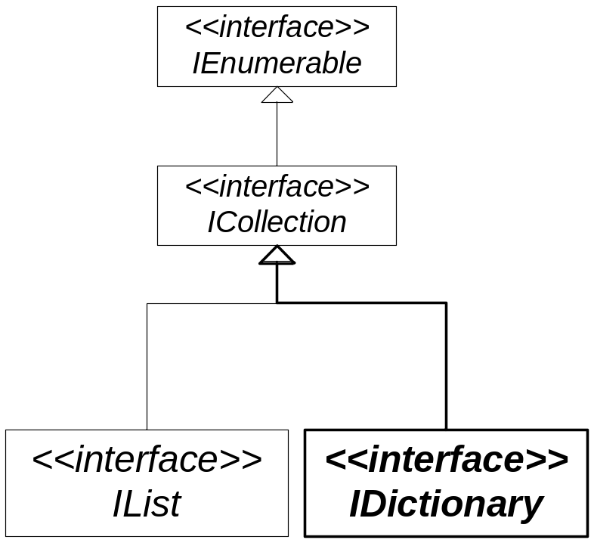
Interface IDictionary
IDictionary is interface for collections of key-value pairs
interface IDictionary : ICollection, IEnumerable {
object this[object key] {get; set;}
void Add(object key, object value);
void Remove(object key);
bool Contains(object key);
ICollection Keys {get;};
ICollection Values {get;};
IDictionaryEnumerator GetEnumerator();
…
}
Indexer for accessing elements by key
Adding,
removing,
containment
Keys
Values
Accessing an iterator for key-value pairs
Notes:
Überblick

Slide 20
IDictionaryEnumerator and DictionaryEntry
IDictionaryEnumerator is iterator over key-value pairs
IDictionaryEntry represents key-value pair
interface IDictionary : ICollection, IEnumerable {
…
IDictionaryEnumerator GetEnumerator();
…
}
public interface IDictionaryEnumerator :
IEnumerator {
//----- Properties
public DictionaryEntry Entry {get;};
public object Key {get;};
public object Value {get;};
}
public struct DictionaryEntry {
//----- Constructor
public DictionaryEntry
(object key, object value);
//----- Properties
public object Key {get;};
public object Value {get;};
}
Notes:
Überblick

Slide 21
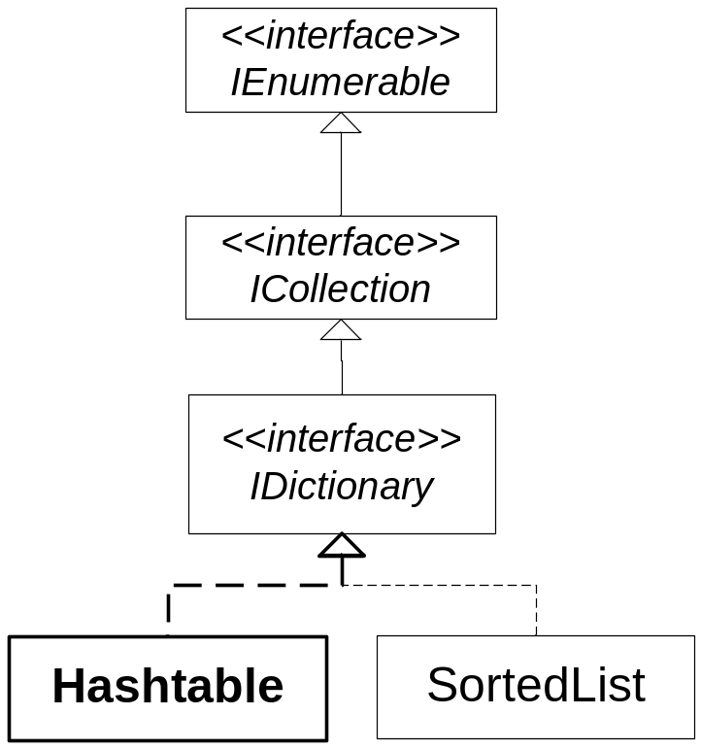
Dictionary Hashtable
Hashtable is an implementation of IDictionary
organised by hash code of keys
  ➔ key objects must implement GetHashCode and Equals methods
public class Hashtable : IDictionary, ICollection, IEnumerable, … {
public Hashtable();
public Hashtable(IDictionary d);
public Hashtable(int capacity);
public virtual object this[object key] {get; set;}
public virtual bool ContainsKey(object key);
public virtual bool ContainsValue(object val);
protected IHashCodeProvider Hcp {get; set;}
…
}
Constructors
Indexer for accessing elements by key
Testing, if key and value contained
Setting and getting a HashCodeProviders !
Notes:
Überblick

Slide 22
Example Hashtable
Creating Hashtable and adding Person objects using the social security number as key
Iterating over the entries and printing out values and keys
Testing for containment of an entry with a particular key
public class Person {
public Person(string fn, string ln) {
…
}
public override string ToString() {
…
}
...
}
Hashtable h = new Hashtable();
h.Add(3181030750, new Person("Mike", "Miller"));
h.Add(1245010770, new Person("Susanne", "Parker"));
h.Add(2345020588, new Person("Roland", "Howard"));
h.Add(1245300881, new Person("Douglas", "Adams"));
foreach (DictionaryEntry x in h)
Console.WriteLine(x.Value + ": " + x.Key);
if (h.Contains(1245010770))
Console.WriteLine("Person mit SNr. 1245010770: " + h[1245010770]);
Notes:
Überblick

Slide 23
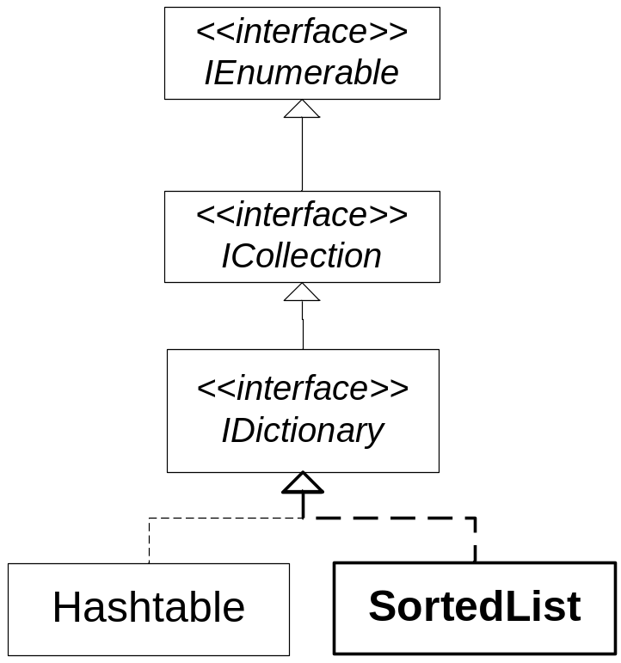
Dictionary SortedList
SortedList is second implementation of IDictionary
dynamic list of key-value pairs sorted by key!
public class SortedList : IDictionary, ICollection, … {
public SortedList();
public SortedList(IComparer c);
public virtual object this[object key] {get; set;};
public virtual object GetByIndex(int i);
public virtual object GetKey(int i);
public virtual IList GetKeyList();
public virtual IList GetValueList();
public virtual int IndexOfKey(object key);
public virtual int IndexOfValue(object value);
public virtual void RemoveAt(int i);
…
}
Constructors
Indexer for accessing elements by key
Accessing values and keys based on index position
List of keys
and values
Position of key
and value
Removing an entry at a given position
Notes:
Überblick

Slide 24
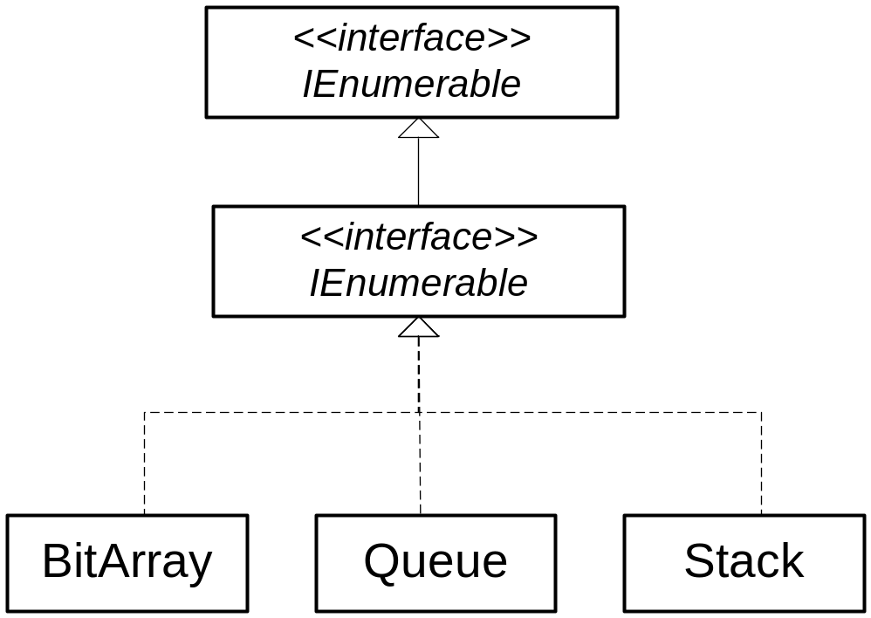
Special Collections
Queue
Stack
BitArray
public class Queue : ICollection, IEnumerable, ICloneable {
public virtual void Clear();
public virtual bool Contains(object o);
public virtual object Dequeue();
public virtual void Enqueue(object o);
public virtual object Peek();
…
}
public class Stack : ICollection, IEnumerable, ICloneable {
public virtual void Clear();
public virtual bool Contains(object o);
public virtual object Peek();
public virtual object Pop();
public virtual void Push(object o);
…
}
ICollection
public sealed class BitArray : ICollection, IEnumerable, ICloneable {
public bool this[int index] {get; set;}
public int Length {get; set;}
public BitArray And(BitArray val);
public BitArray Not();
public BitArray Or(BitArray a);
…
}
Notes:
Überblick

Slide 25
.NET Framework Class Library
Overview
Collections
Untyped Collections
Typed Collections
Reflection
Threading
Streaming
Processing XML Data
Networking
Windows Forms
Summary
Notes:
Überblick

Slide 26
Generic Collections
Namespace System.Collections.Generic provides generic classes for collections
IEnumerable
IEnumerator
IEnumerable<T>
IEnumerator<T> GetEnumerator()
IEnumerator<T>
T Current
ICollection<T>
int Count
void Clear()
bool Contains(T item)
void Add(T item)
void Remove(T item)
void CopyTo(Array a, int pos)
Stack<T>
Queue<T>
IComparable
IComparable<T>
int CompareTo(T obj ))
IComparer
IList<T>
T this[int i]
void Insert(int pos, T x)
void RemoveAt(int pos)
int IndexOf(T x)
LinkedList<T>
IComparer<T>
int Compare(T x, T y)
Comparer<T>
List<T>
Notes:
Überblick

Slide 27
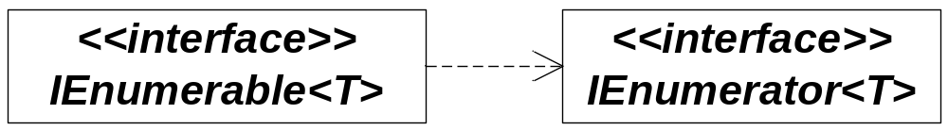
IEnumerable<T> and IEnumerator<T> (1)
interface IEnumerable<T> for anything which is enumerable
IEnumerator<T> realizes an iterator
Type parameter T defines type of elements !
interface IEnumerable<T> : IEnumerable {
IEnumerator<T> GetEnumerator();
}
interface IEnumerator<T> : IEnumerator {
T Current {get;}
bool MoveNext();
void Reset();
}
Notes:
Überblick

Slide 28
IEnumerable<T> and IEnumerator<T> (2)
Use foreach-statement with IEnumarables
Example: Array
public class Person {
public string ssNr;
public string name;
public Person(string ssNr, string name) {
this.ssNr = ssNr;
this.name = name;
}
public override string ToString() {
return ssNr + ", " + name;
}
}
Person[] persons = new Person[10];
foreach (Person p in persons)
System.Console.WriteLine(p.ToString());
Notes:
Überblick

Slide 29
IEnumerable<T> and IEnumerator<T> (3)
Use foreach-statement with IEnumarables
Example: List<T>
public class Person {
public string ssNr;
public string name;
public Person(string ssNr, string name) {
this.ssNr = ssNr;
this.name = name;
}
public override string ToString() {
return ssNr + ", " + name;
}
}
List<Person> persons = new List<Person>();
foreach (Person p in persons)
System.Console.WriteLine(p.ToString());
Notes:
Überblick

Slide 30
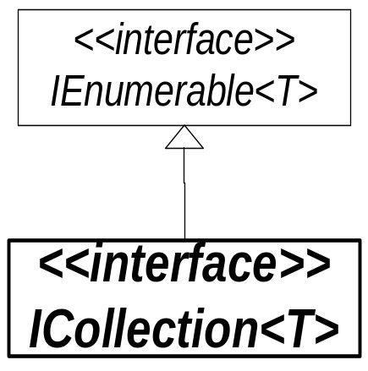
Interface ICollection<T>
Base interface for collections
interface ICollection<T>:
IEnumarable<T> {
//---- Properties
int Count {get;}
bool IsReadOnly {get;}
//---- Methods
void Add(T elem);
bool Remove(T elem);
void Clear();
bool Contains(T elem);
void CopyTo(T[] a, int index);
}
  number of elements
  read only?
  adding an element
  removing an element
  remove all
  containment
  copies elements into array a (beginning at position index)
Notes:
Überblick

Slide 31
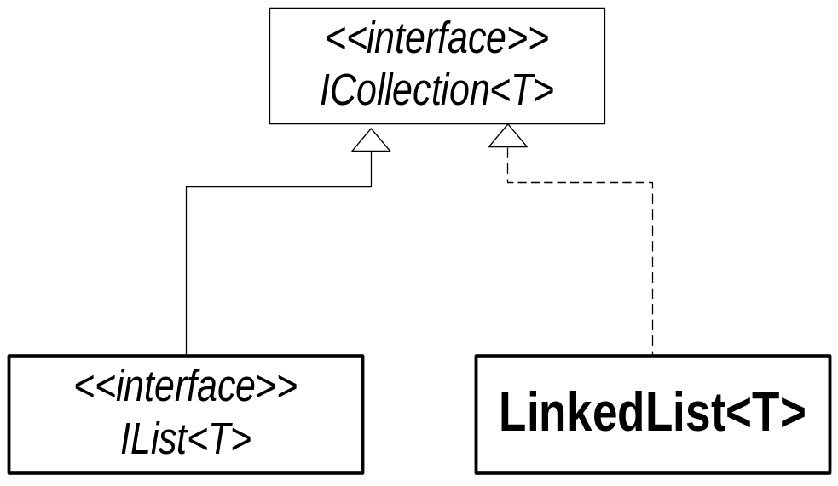
Class LinkedList<T>
Linked list implementation of ICollection<T>
works with LinkedListNode<T>
public class sealed LinkedListNode<T> {
public T Value { get; set; }
public LinkedListNode<T> Next { get; }
public LinkedListNode<T> Previous { get; }
}
public class LinkedList<T>: ICollection<T> {
//---- Properties
…
public LinkedListNode<T> First { get; }
public LinkedListNode<T> Last { get; }
//---- Methods
public LinkedListNode<T> AddFirst ( T value)
public LinkedListNode<T> AddLast ( T value)
public LinkedListNode<T> AddAfter ( LinkedListNode<T> node, T value )
…
}
  first node
  last node
  add first node with value
  add last node with value
  add new node after node
Notes:
Überblick

Slide 32
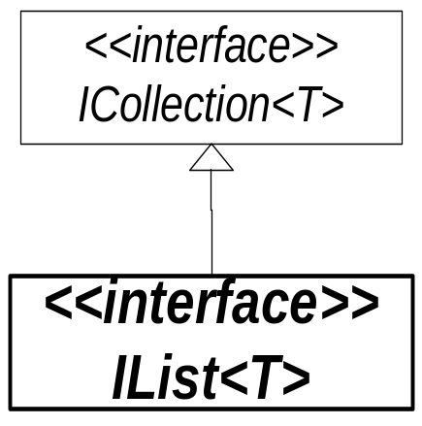
Interface IList<T>
Interface for collections with positioned access
interface IList<T>: ICollection<T>: {
//---- Properties
T this[int index] {get; set;}
//---- Methods
void Insert(int index, T elem);
bool RemoveAt(int index);
int IndexOf(T elem);
}
  Indexer for direct access
  adding an element at position index
  removing an element at position index
  Position of element elem
Notes:
Überblick

Slide 33
IComparable<T> and IComparer<T>
IComparable<T> is interface for types with order
IComparer<T> is interface for realizing comparison objects
public interface IComparable<T> {
int CompareTo(T obj); // -1 if x < y, 0 if x == y, 1 if x > y
}
public interface IComparer <T> {
int Compare(T x, T y); // -1 if x < y, 0 if x == y, 1 if x > y
}
Notes:
Überblick

Slide 34
Example IComparer<T>
Base class Person
Comparer for Persons
public class PersonComparer<T> : IComparer<T> where T: Person {
// compare SSN of persons 1 and 2
public int Compare(T person1, T person2) {
return person1.svNr.CompareTo(person2.svNr);
}
}
public class TestComparer {
public static void Main(string[] argv) {
Person[] persons = { new Person("030819778345", "Herbert Miller"),
new Person("010519506534", "Mary Master"),
new Person("100719654298", “Harry Monster") };
Array.Sort(persons, new PersonComparer<Person>());
foreach (Person p in persons) {
Console.WriteLine(p.ToString());
}
}
}
010519506534, Mary Master
030819778345, Herbert Miller
100719654298, Harry Monster
Notes:
Überblick

Slide 35
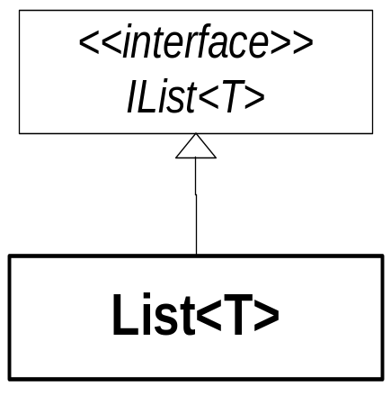
Class List<T> (1)
Standard implementation of IList<T>
public class List<T> : IList<T>, ICollection<T>, IEnumerable<T> {
// IEnumerable<T>: GetEnumerator
// ICollection<T>: Count, CopyTo, Add, Contains, ...
// IList<T>: Insert, RemoveAt, IndexOf, ...
//----- Constructors
public List();
public List(IEnumerable<T> collection);
public List(int capacity);
//----- Properties
virtual int Capacity {get; set;}
public int Count { get; }
public T this [int index] { get; set; }
…
  properties and methods of implemented interfaces
  constructors
  reserved space in list
  number of elements
  indexer for positioned access
Notes:
Überblick

Slide 36
Class List<T>(2)
//----- Methods
public virtual IList<T> GetRange(int index, int count);
public virtual void AddRange(IEnumerable<T> c);
public virtual void InsertRange(int i, IEnumerable<T> c);
public virtual void RemoveRange(int index, int count); public virtual int LastIndexOf(T e);
public virtual int BinarySearch(T e);
public virtual int BinarySearch(T e, IComparer<T>);
public virtual void Sort();
public virtual void Reverse();
public virtual T[] ToArray();
public virtual void TrimExcess();
}
subset
adding a set of elements
inserting a set of elements
removing a set of elements
last position where e occurs
binary serach for e
binary search with IComparer
sorting
inversion of elements
copying elements into T[] array
setting capacity to current number of elements
Notes:
Überblick

Slide 37
Example List<T> (1)
using System;
using System.Collections.Generic;
...
List<Person> list = new List<Person>();
list.Add(new Person("030819778345", "Herbert Miller"));
list.Add(new Person("010519506534", "Mary Master"));
list.Add(new Person("100719654298", "Harry Monster"));
list.Sort(new PersonComparer<Person>());
foreach (Person p in list) Console.WriteLine(p);
Output:
010519506534, Mary Master
030819778345, Herbert Miller
100719654298, Harry Monster
list.Reverse();
for (int i = 0; i < list.Count; i++) Console.WriteLine(list[i]);
100719654298, Harry Monster
030819778345, Herbert Miller
010519506534, Mary Master

Slide 38
Example List<T> (2)
using System;
using System.Collections.Generic;
...
List<string> list = new List<string>();
list.Add("Anton"); list.Add("Dora"); list.Add("Berta"); list.Add("Emil"); list.Add("Caesar");
list.Sort();
int i = list.BinarySearch("Emil");
Console.WriteLine("Pos. {0}: {1}", i, list[i]);
Pos. 4: Emil
StringComparer ignoreCaseComparer = StringComparer.CurrentCultureIgnoreCase;
i = list.BinarySearch("berta", ignoreCaseComparer);
Console.WriteLine(" Pos. {0}: {1}", i, list[i]);
Pos. 1: Berta
//----- Conversion to static array
string[] arr = list.ToArray();
foreach (string s in arr) Console.WriteLine(s);
Anton
Berta
…

Slide 39
Class Queue<T>
Queue<T> realizes buffer with FIFO strategy
public class Queue<T> : ICollection, IEnumerable<T> {
// IEnumerable<T>: GetEnumerator
// ICollection<T>: Count, CopyTo, ...
public Queue();
public Queue(IEnumerable<T> c);
public Queue(int capacity);
//----- Methods
public virtual void Enqueue(T elem); public virtual T Dequeue();
public virtual T Peek();
…
}
implementation of interfaces ICollection and IEnumerable
constructors
appending element in the back
removing first element
accessing first element without removing it

Slide 40
Example Queue<T>
using System;
using System.Collections.Generic;
...
Queue<string> q = new Queue<string>();
q.Enqueue("Anton"); q.Enqueue("Berta"); q.Enqueue("Caesar"); q.Enqueue("Dora");
while (q.Count > 0) Console.Write(q.Dequeue());
Anton Berta Caesar Dora

Slide 41
Class Stack<T>
Stack<T> realizes generic stack with LIFO strategy
public class Stack<T> : ICollection, IEnumerable<T> {
// IEnumerable<T>: GetEnumerator
// ICollection<T>: Count, CopyTo, ...
//----- Constructors
public Stack();
public Stack(IEnumerable<T> c);
public Stack(int capacity);
//----- Methods
public virtual void Push(T elem);
public virtual T Pop();
public virtual T Peek();
…
}
implementation of interfaces ICollection und IEnumerable
constructors
putting element on the stack
removing topmost element
reading topmost element without removing it

Slide 42
Example Stack<T>
Stack<string> s = new Stack<string>();
s.Push("Anton"); s.Push("Berta"); s.Push("Caesar"); s.Push("Dora");
while (s.Count > 0) Console.Write(s.Pop());
Dora Caesar Berta Anton

Slide 43
Generic Dictionary Classes
Generic types for mappings from keys to values
ICollection <KeyValuePair<int, Person>>
ICollection <KeyValuePair <TKey, TValue> >
IDictionary <TKey, TValue>
ICollection<TKey> Keys
ICollection<TValue> Values
TValue this[TKey key]
void Add(TKey key, TValue value)
void Remove(TKey key)
bool ContainsKey(TKey key)
bool TryGetValue(TKey key, out TValue value)
IDictionary <int, Person>
Dictionary <TKey,TValue>
SortedList <TKey,TValue>
SortedDictionary <TKey,TValue>
Realization with hashtable
Realization with array
Realization with tree

Slide 44
Interface IDictionary<TKey, TValue>
General interface for mappings from keys to values
public struct KeyValuePair<TKey, TValue> {
public KeyValuePair(TKey key, TValue value);
public TKey Key {get; } p
public TValue Value {get; }
}
interface IDictionary<TKey, TValue>:
ICollection<KeyValuePair<TKey, TValue>>,
IEnumerable<KeyValuePair<TKey, TValue>> {
// inherits from ICollection<T>: Count, CopyTo, ...
//----- Properties
ICollection<TKey> Keys {get;}
ICollection<TValue> Values {get;}
TValue this[TKey key] {get; set;}
//----- Methods
void Add(TKey key, TValue value);
void Remove(TKey key);
bool ContainsKey(TKey key);
bool TryGetValue(TKey key, out TValue value);
}
Acess to:
set of keys
set of values
value for an key
adding a key-value pair
Removing a value for a key
Checking if value for key contained
trial to access value for an key;
returns false if unsuccessful

Slide 45
Class Dictionary<TKey, TValue>
Implementation of IDictionary<TKey, TValue> with hashtable
public class Dictionary<TKey, TValue> :
IDictionary<TKey, TValue>, ICollection<KeyValuePair<TKey, TValue>>,
IEnumerable<KeyValuePair<TKey, TValue>>, ... {
//----- implemented interfaces
// ICollection: Count, CopyTo, ...
// IDictionary: Clear, Add, Remove, Contains, GetEnumerator, Indexer, ...
//----- Constructors
public Dictionary();
public Dictionary(int capacity);
public Dictionary(IEqualityComparer<TKey> comparer);
public Dictionary(IDictionary<TKey, TValue> d);
//----- Methods
public virtual bool ContainsKey(TKey key);
public virtual bool ContainsValue(TValue val);
...
}

Slide 46
Example Dictionary<TKey, TValue>
Dictionary with SSN as keys and Person-objects as values
public class DictionaryExample {
public static void Main() {
Dictionary<long, Person> tab = new Dictionary<long, Person>();
tab.Add(3181030750, new Person("3181030750", "Mike Miller"));
tab.Add(1245010770, new Person("1245010770", "Susanne Parker"));
tab.Add(2345020588, new Person("2345020588", "Roland, Howard"));
tab.Add(1245300881, new Person("1245300881", "Douglas Adams"));
foreach (KeyValuePair<long, Person> e in tab)
Console.WriteLine(e.Value + ": " + e.Key);
if (tab.ContainsKey(1245010770))
Console.WriteLine("Person with SSN 1245010770: " + tab[1245010770]);
}
}
3181030750, Mike Miller: 3181030750
1245010770, Susanne Parker: 1245010770
2345020588, Roland, Howard: 2345020588
1245300881, Douglas Adams: 1245300881
Person with SSN 1245010770: 1245010770, Susanne Parker

Slide 47
Class SortedDictionary<TKey, TValue>
Sorted according to keys
Implementation with tree
public class SortedDictionary<TKey, TValue> :
IDictionary<TKey, TValue>, ICollection<KeyVauePair<TKey, TValue>>,
IEnumerable<KeyVauePair<TKey, TValue>>, ... {
//----- Constructors
public SortedDictionary();
public SortedDictionary(IComparer<TKey> c);
…
//----- Properties
public virtual IComparer<TKey> Comparer { get; }
public virtual TValue this [ TKey ] { get; set; }
//----- Methods
public virtual void Add(TKey key, TValue value); // adds key-value pair
public virtual void RemoveAt(int i); // removes key-value pair with position i
public virtual bool ContainsKey(TKey key); // key contained?
public virtual bool ContainsValue(TValue val); // value contained?
public virtual int IndexOfKey(TKey key); // returns position of key
public virtual int IndexOfValue(TValue value); // returns position of value …
}

Slide 48
Example SortedDictionary<TKey, TValue>
Create a SortedDictionary-Objects with <long, Person>
Adding of Person-objects with SSN as key
Output of entries in sorted order
SortedDictionary<long, Person> persons = new SortedDictionary<long, Person>();
persons.Add(3181030750, new Person("Mike", "Miller"));
persons.Add(1245010770, new Person("Susanne", "Parker"));
persons.Add(2345020588, new Person("Roland", "Howard"));
persons.Add(1245300881, new Person("Douglas", "Adams"));
foreach (KeyValuePair<long, Person> pEntry in persons) {
long ssn = pEntry.Key;
Person person = pEntry.Value;
System.Console.WriteLine("SSN {0} : {1}", ssn, person.ToString());
}
SSN 1245010770 : Susanne Parker
SSN 1245300881 : Douglas Adams
SSN 2345020588 : Roland Howard
SSN 3181030750 : Mike Miller

Slide 49
Iterators

Slide 50
Iterators so far
foreach loop can be applied to objects of classes which implement IEnumerable
class MyClass: IEnumerable {
...
public IEnumerator GetEnumerator() {
return new MyEnumerator(...);
}
class MyEnumerator: IEnumerator {
public object Current { get {...} }
public bool MoveNext() {...}
public void Reset() {...}
}
}
interface IEnumerable {
IEnumerator GetEnumerator();
}
MyClass x = new MyClass();
...
foreach (object obj in x) ...
complicated to implement!!

Slide 51
Iterator Methods
class MyClass {
string first = "first";
string second = "second";
string third = "third";
...
public IEnumerator GetEnumerator() {
yield return first;
yield return second;
yield return third;
}
}
Characteristics of an interator method
has the signature
public IEnumerator GetEnumerator
statement body contains at least
one yield statement
MyClass x = new MyClass();
...
foreach (string s in x) Console.Write(s + " ");
// prints "first second third"
How does an iterator method work?
returns a sequence of values
foreach loop traverses this sequence
Note
MyClass need not implement IEnumerable!
Instead of IEnumerator it is better to use IEnumerator<string> (avoids a type cast)
IEnumerator<T> is in System.Collections.Generic

Slide 52
What Happens Behind the Scene?
returns an object of the following
compiler-generated class
public IEnumerator<int> GetEnumerator() {
try {
...
} finally {
...
}
}
class _Enumerator : IEnumerator<int> {
int Current { get {...} }
bool MoveNext() {...}
void Dispose() {...}
}
is translated into
foreach (int x in list)
Console.WriteLine(x);
IEnumerator<int> _e = list.GetEnumerator();
try {
while (_e.MoveNext())
Console.WriteLine(_e.Current);
} finally {
if (_e != null) _e.Dispose();
}
MoveNext runs to the next yield statement
Dispose executes a possibly existing
finally block in the iterator method

Slide 53
yield Statement
2 kinds
(may only occur in iterator methods)
yield return expr;
yields a value for the next iteration of the foreach loop
type of expr must be compatible with
- T (if IEnumerator<T>)
- object (if IEnumerator)
yield break;
terminates the iteration

Slide 54
Specific Iterators
class MyList {
int[] data = ...;
public IEnumerator<int> GetEnumerator() {
for (int i = 0; i < data.Length; i++)
yield return data[i];
}
}
Standard iterator
public IEnumerable<int> Range(int from, int to) {
if (to > data.Length) to = data.Length;
for (int i = from; i < to; i++)
yield return data[i];
}
Specific iterator as a method
arbitrary name and parameter list
result type IEnumerable or IEnumerable<T>
must contain a yield statement
public IEnumerable<int> Downwards {
get {
for (int i = data.Length - 1; i >= 0; i--)
yield return data[i];
}
}
Specific iterator as a property
arbitrary name
result type IEnumerable or IEnumerable<T>
must contain a yield statement
MyList list = new MyList();
foreach (int x in list) Console.WriteLine(x);
foreach (int x in list.Range(2, 7)) Console.WriteLine(x);
foreach (int x in list.Downwards) Console.WriteLine(x);

Slide 55
How Specific Iterators are Compiled
returns an object of the following class
public IEnumerable<int> Range(int from, int to) {
if (to > data.Length) to = data.Length;
for (int i = from; i < to; i++)
yield return data[i];
}
class _Enumerable : IEnumerable<int> {
IEnumerator<int> GetEnumerator() {...}
}
this returns an object of the following class
class _Enumerator : IEnumerator<int> {
int from, to;
int Current { get {...} }
bool MoveNext() {...}
void Dispose() {..}
}
is translated into
foreach (int x in list.Range(2, 7))
Console.WriteLine(x);
IEnumerator<int> _e =
list.Range(2, 7).GetEnumerator();
try {
while (_e.MoveNext())
Console.WriteLine(_e.Current);
} finally {
if (_e != null) _e.Dispose();
}

Slide 56
Example: Iterating Over a Tree
class Tree {
Node root = null;
public void Add(int val) {...}
public bool Contains(int val) {...}
public IEnumerator<int> GetEnumerator() {
return root.GetEnumerator();
}
}
Usage
class Node {
public int val;
public Node left, right;
public Node(int x) { val = x; }
public IEnumerator<int> GetEnumerator() {
if (left != null)
foreach (int x in left) yield return x;
yield return val;
if (right != null)
foreach (int x in right) yield return x;
}
}
...
Tree tree = new Tree();
...
foreach (int x in tree)
Console.WriteLine(x);
Creates an enumerator object for every
node of the tree!

